Slide 1

Dive in Computer Vision Tensor Flow
Pattern Recognition
Mon Aug 23, 2021
Kt.Kim (firefoxdev@kakao.com)

Slide 2
Outline
Why Deep Neural Network
Basic Elements in Deep Neural Network
Mathematics for Machine & Deep Learning
Hands on TensorFlow & TensorBoard
TensorFlow MLP implementation with MNIST DataSample
Q & A

Slide 3
Outline
Why Deep Learning
Basic Elements in Deep Learning
Mathematics for Machine & Deep Learning
Hands on TensorFlow & TensorBoard
TensorFlow MLP implementation with MNIST DataSample
Q & A

Slide 4
Why Deep Learning
State of the Arts

Slide 5
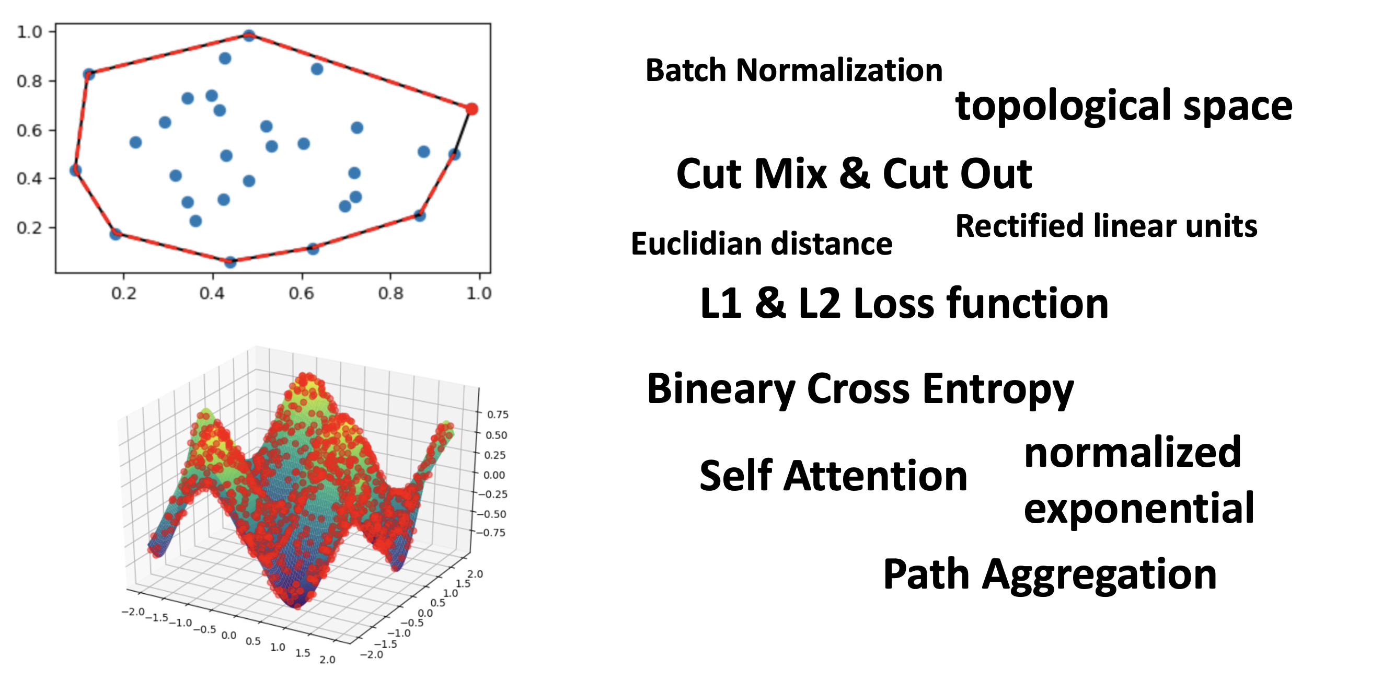
Why Deep Learning

Slide 6
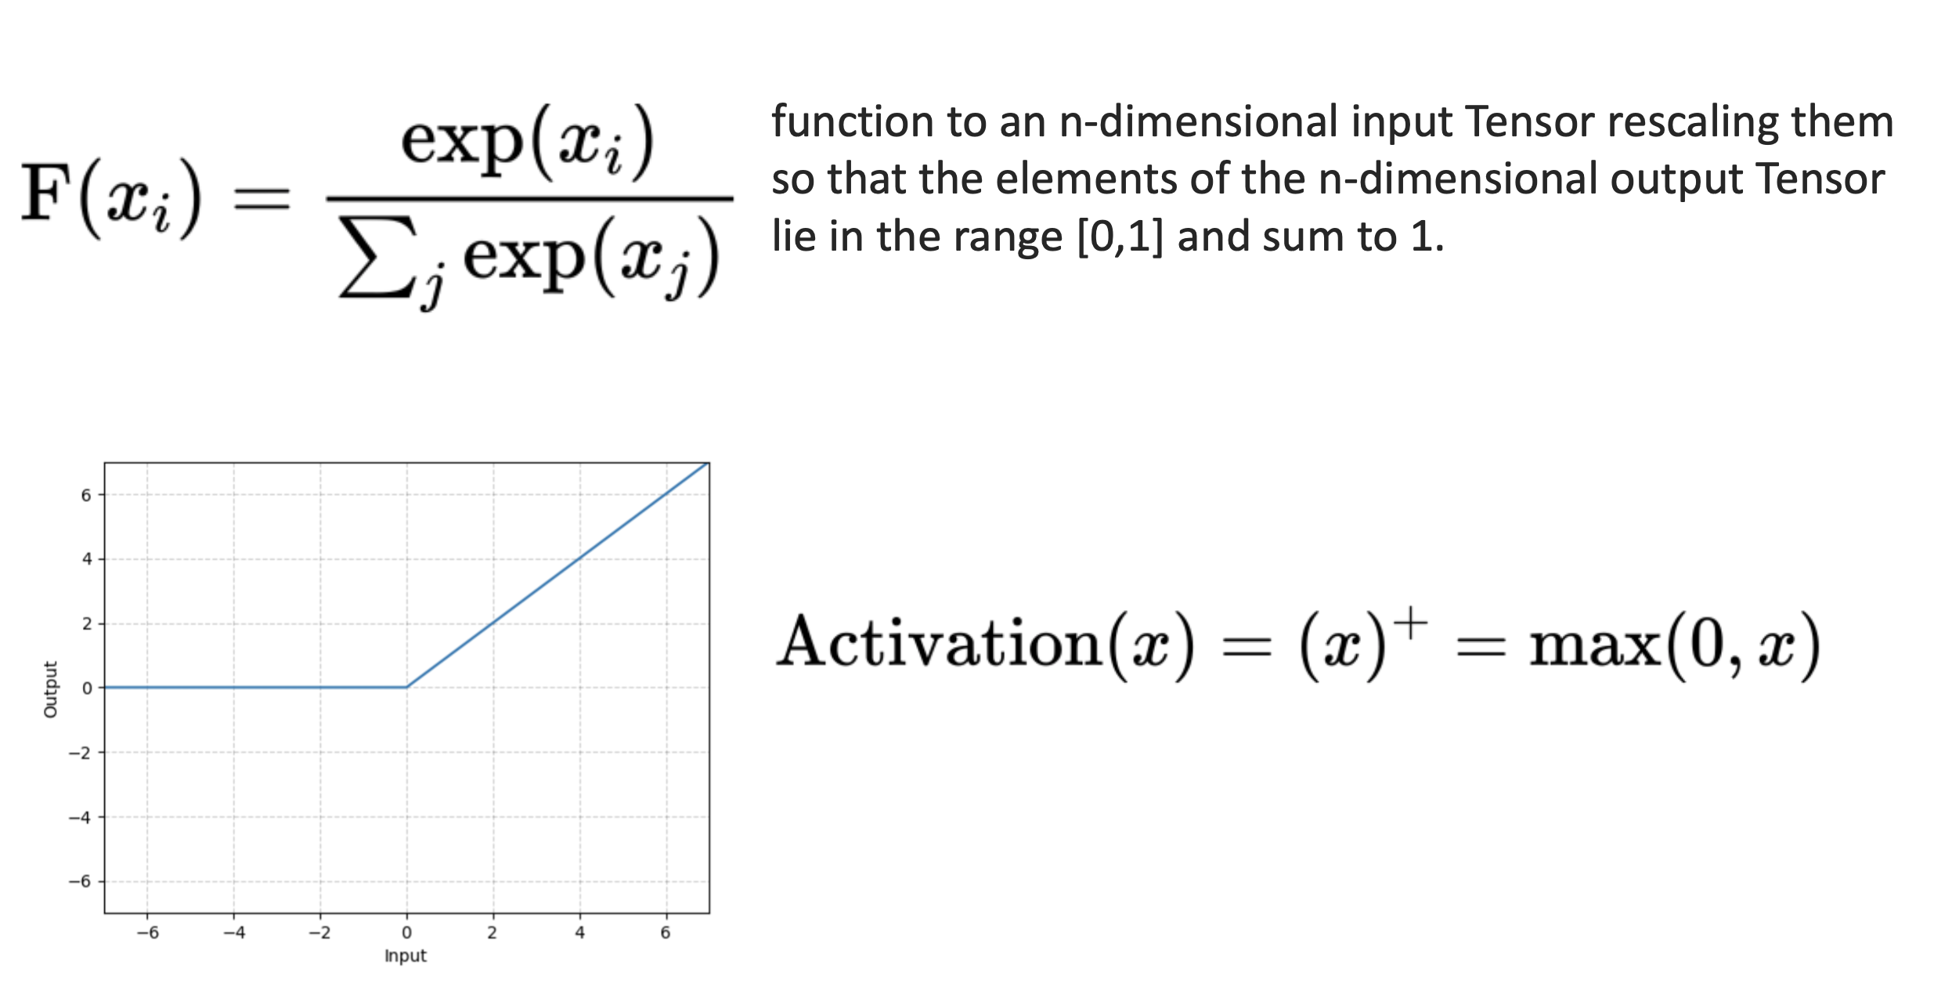
Why Deep Learning

Slide 7
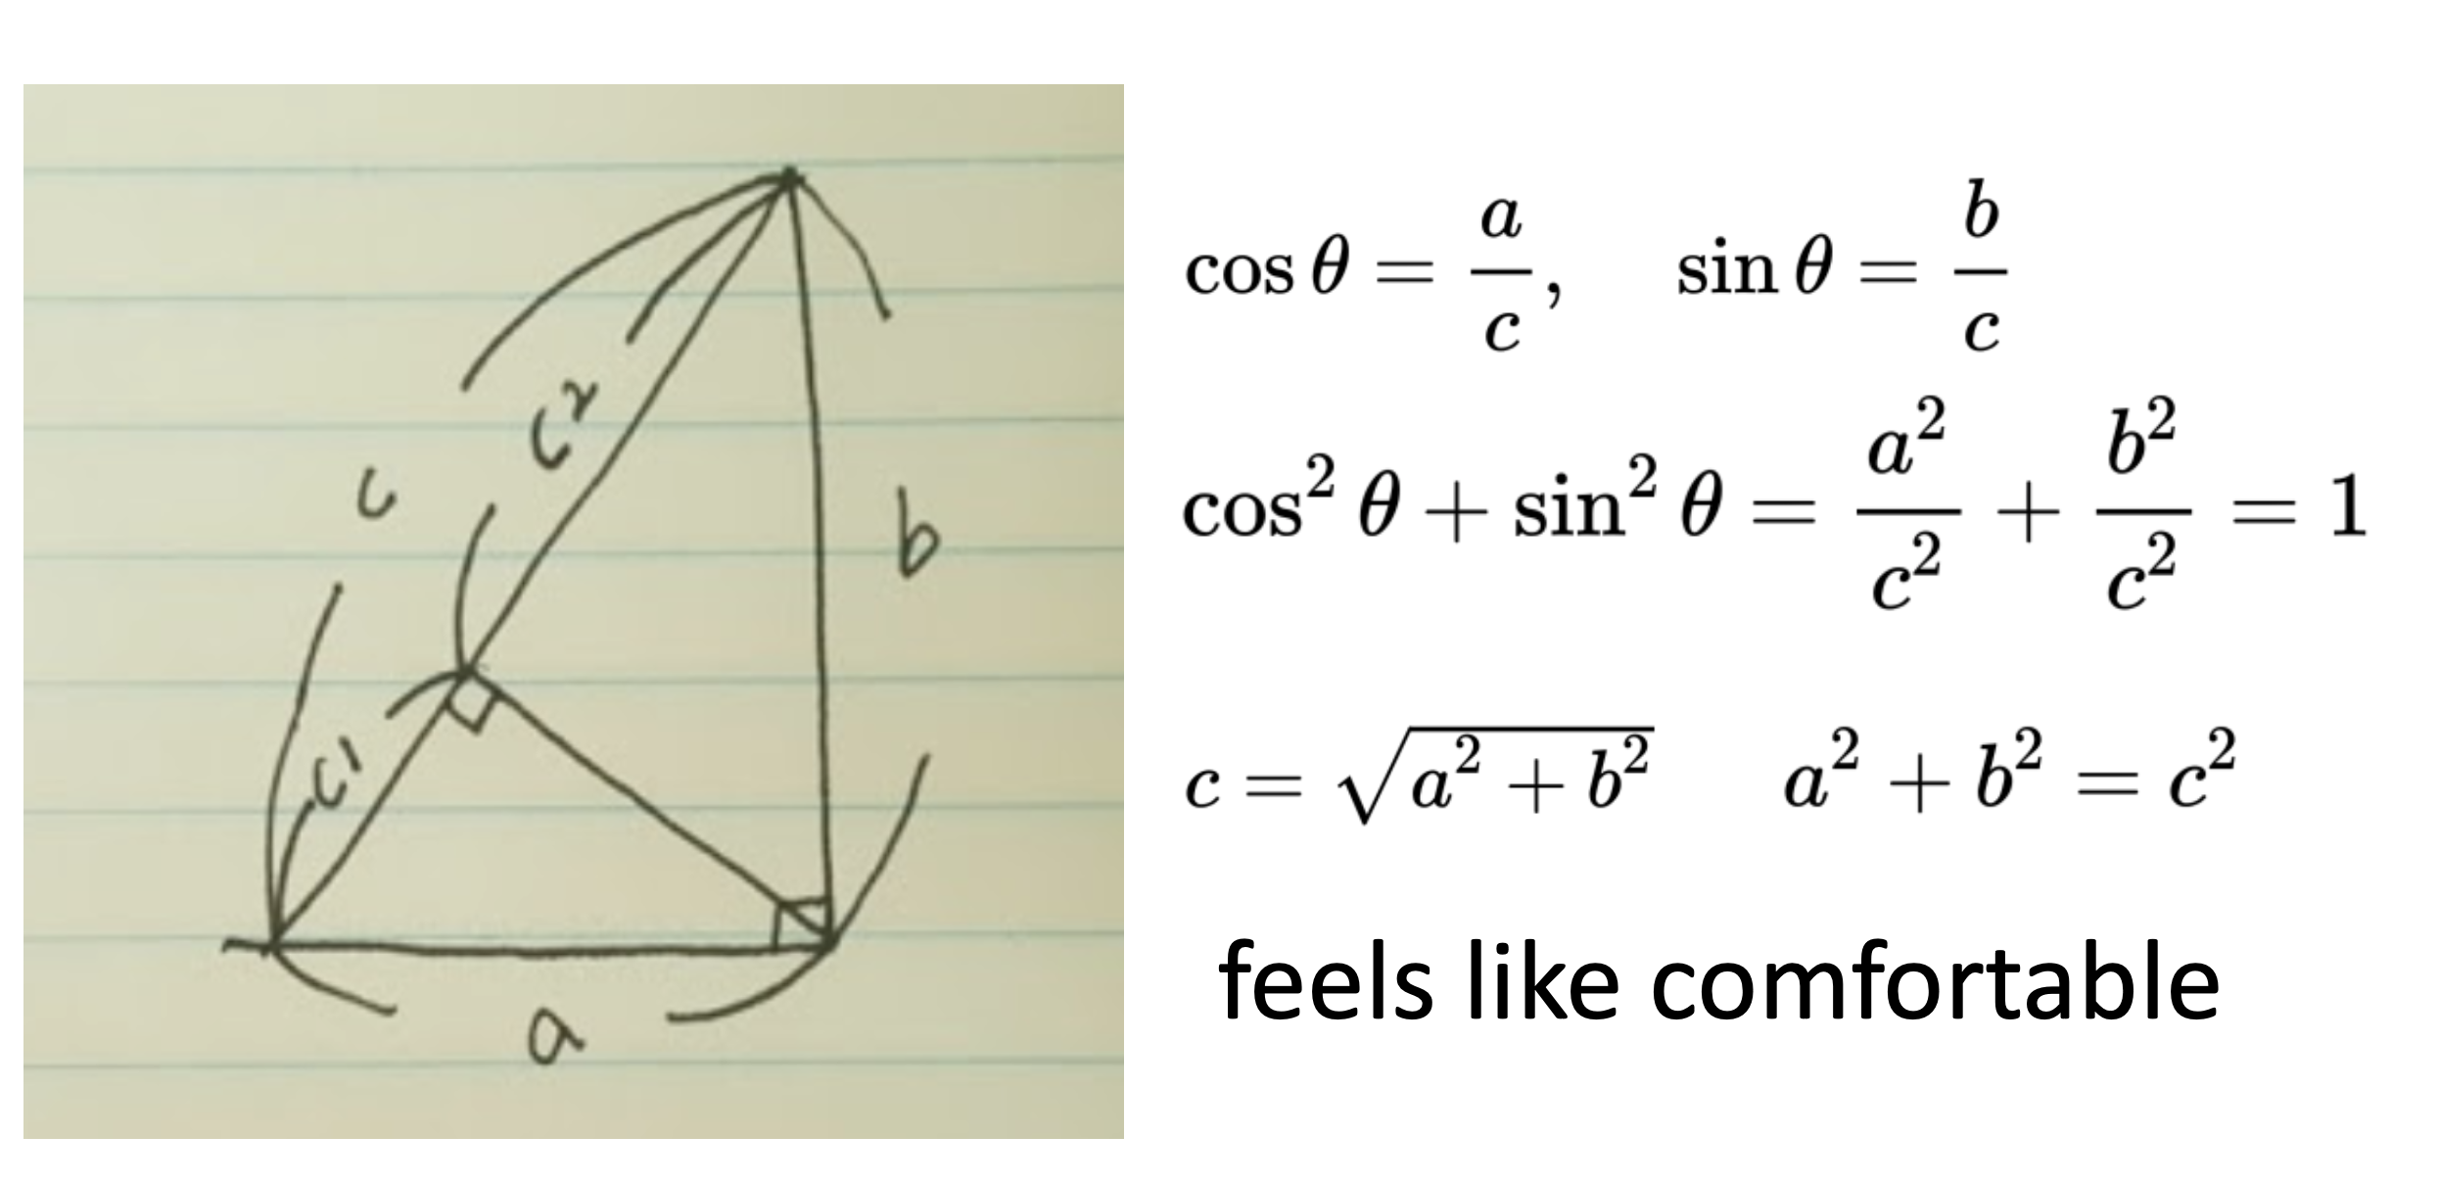
Why Deep Learning

Slide 8
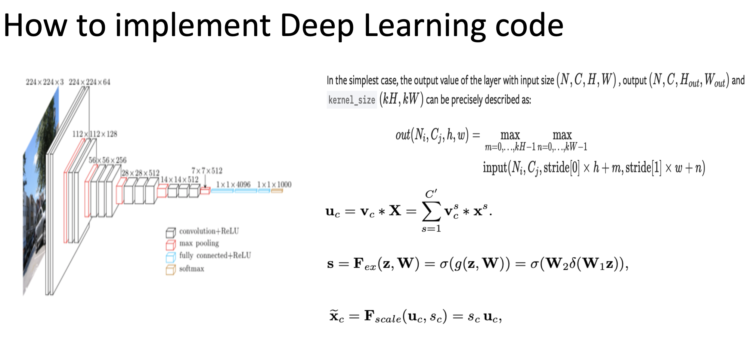
Why Deep Learning

Slide 9
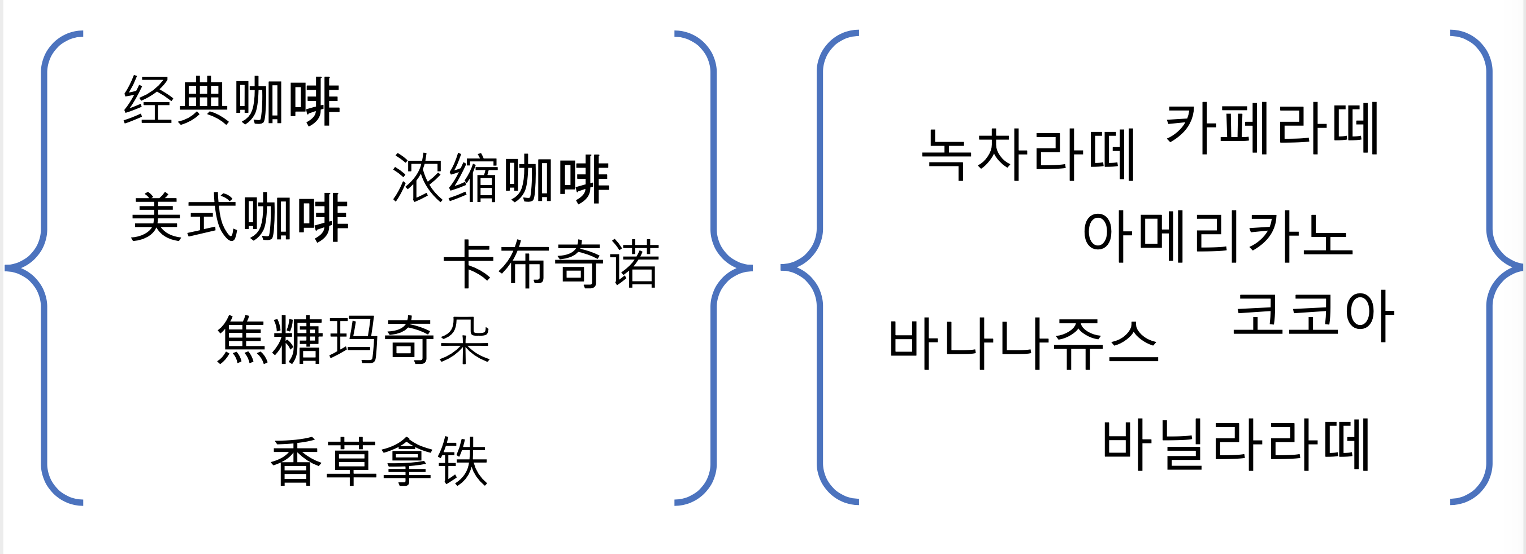
Why Deep Learning

Slide 10
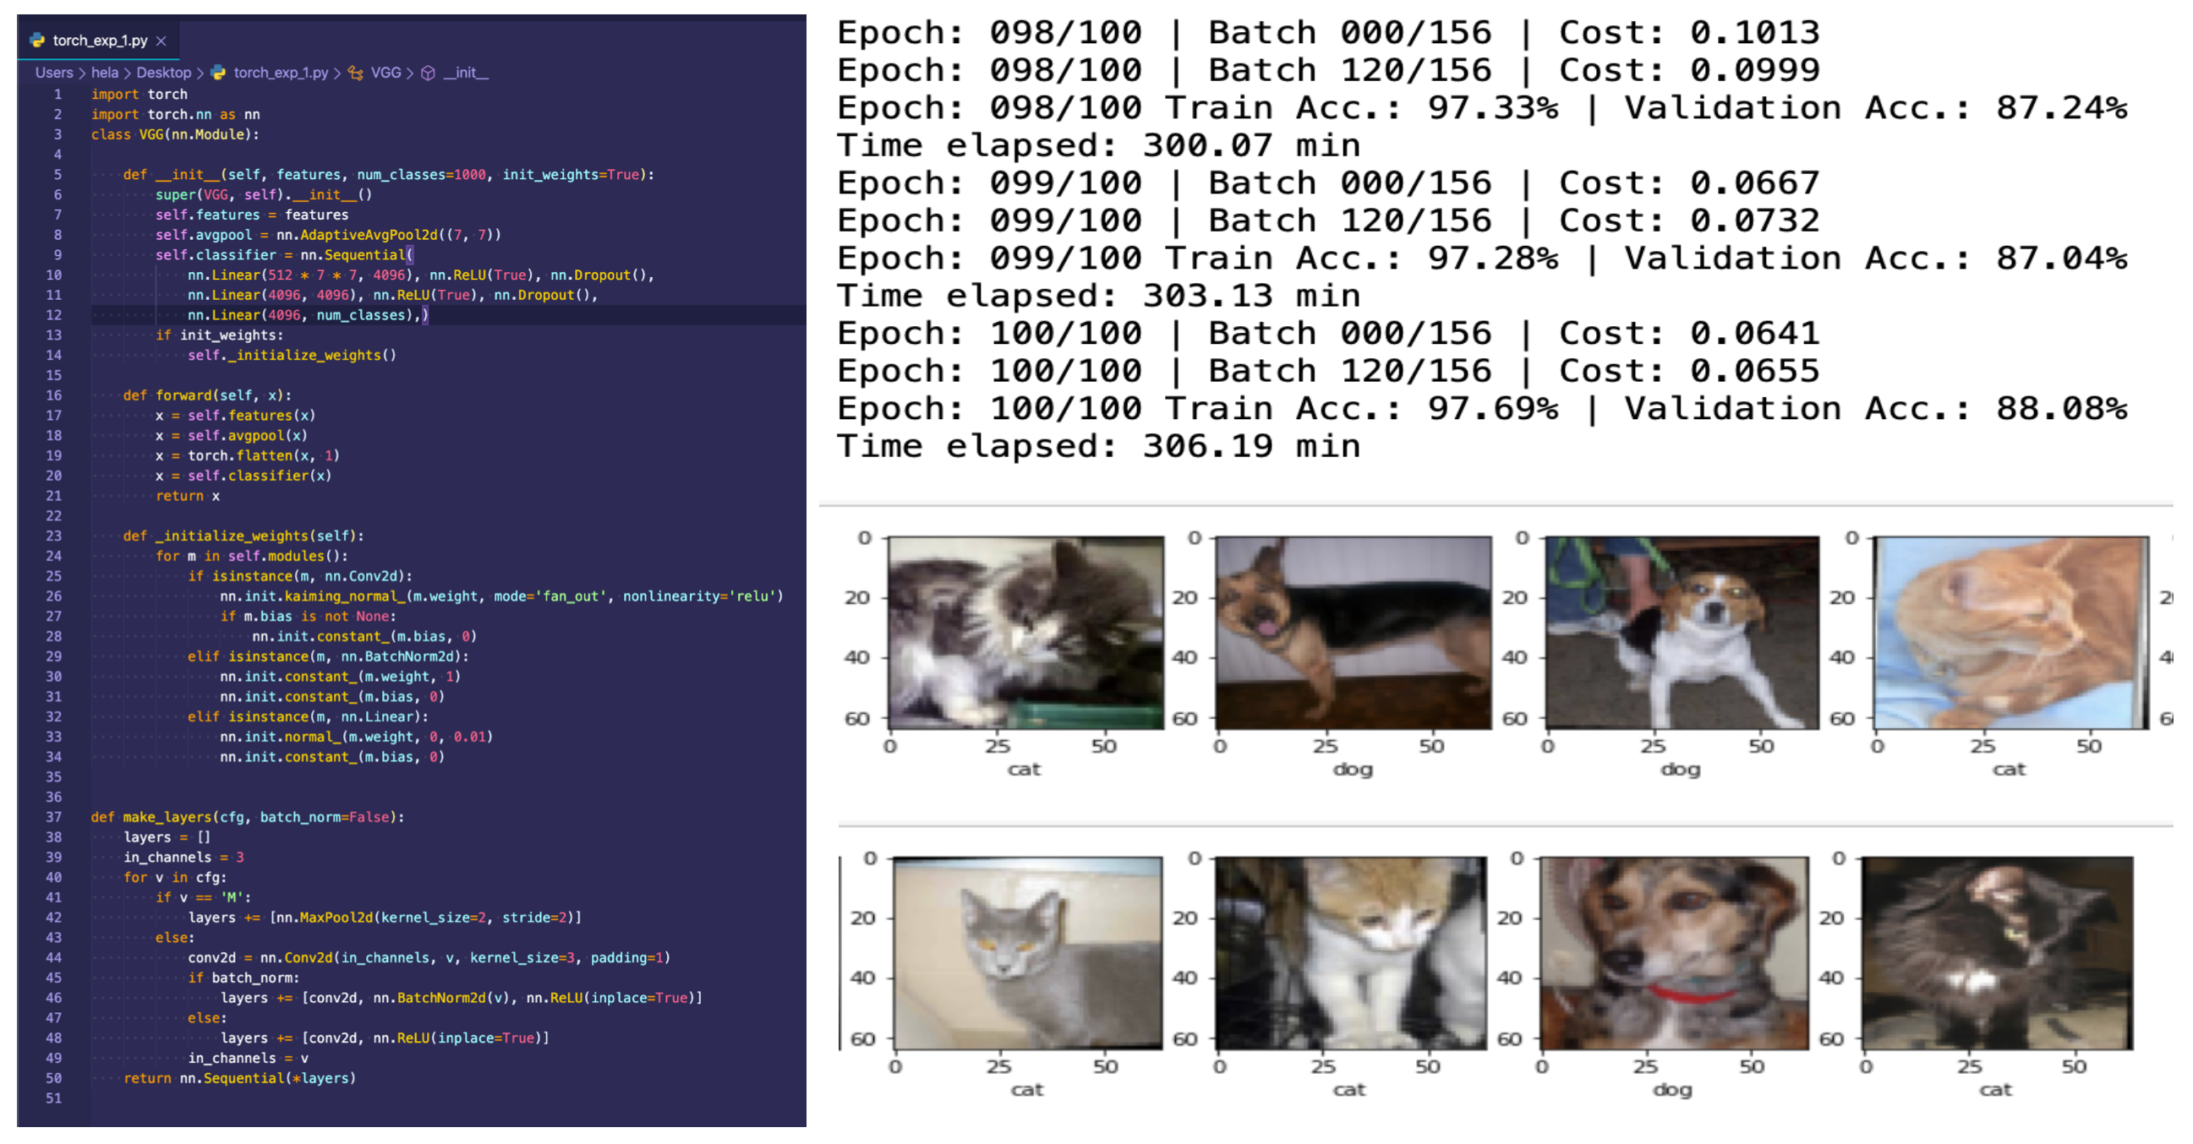
Why Deep Learning

Slide 11
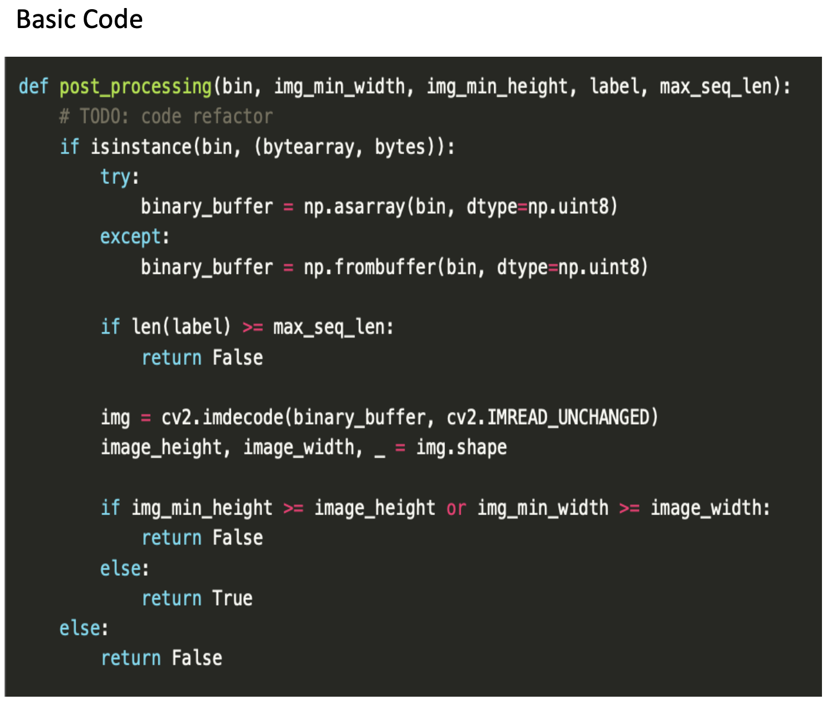
Why Deep Learning
Call by Reference
The call by reference method of passing arguments to a function copies the address of an argument into the formal parameter. Inside the function, the address is used to access the actual argument used in the call. It means the changes made to the parameter affect the passed argument.
2. Call by Value
The call by value method of passing arguments to a function copies the actual value of an argument into the formal parameter of the fn In this case, changes made to the parameter inside the function have no effect on the argument.

Slide 12
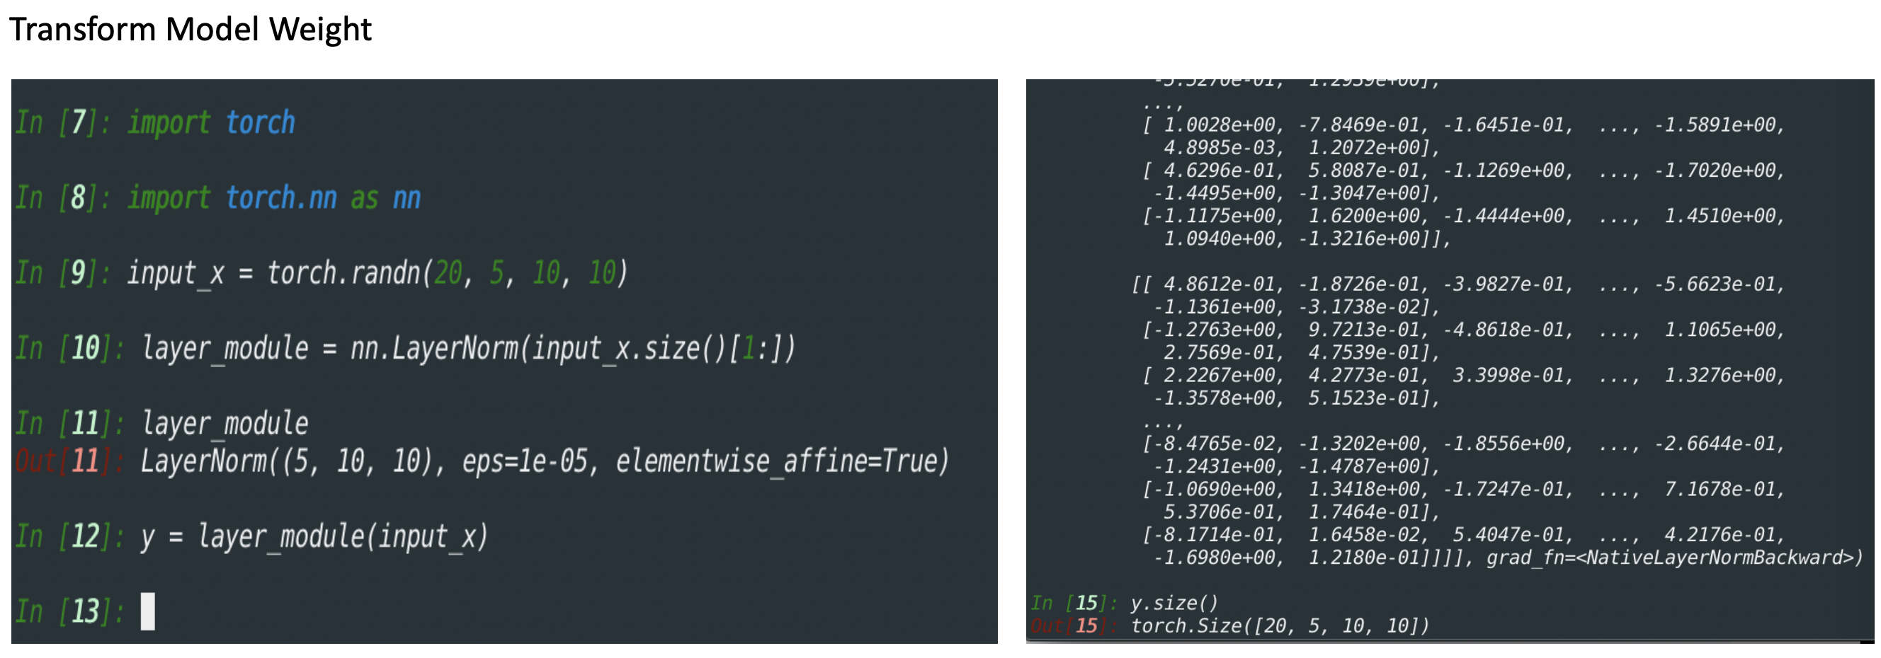
Why Deep Learning
Models can be trained by modifying their parameters in order to achieve better results. It is possible to say that models are representations of what a Deep Learning system has learned from the training data

Slide 13
Outline
Why Deep Learning
Basic Elements in Deep Learning
Mathematics for Machine & Deep Learning
Hands on TensorFlow & TensorBoard
TensorFlow MLP implementation with MNIST DataSample

Slide 14
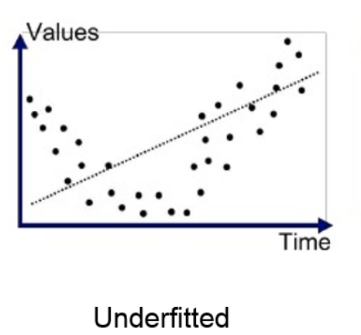
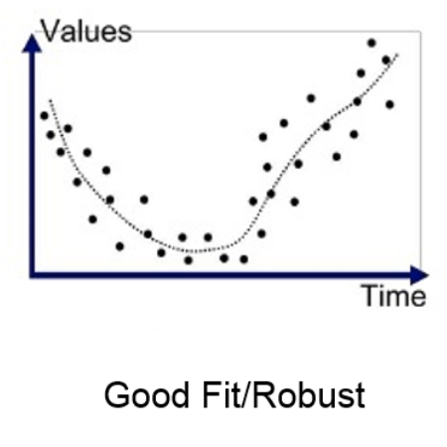
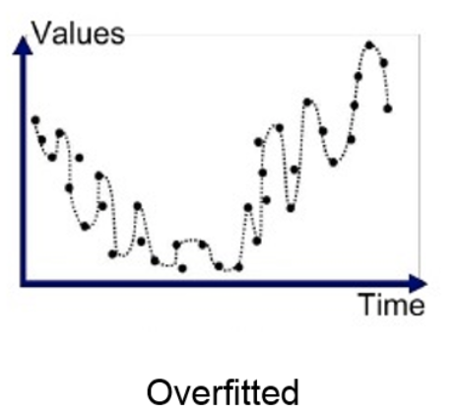
Basic Elements in Deep Learning
Under: model where some parameters or terms that would appear in a correctly specified model are missing
Over: the production of an analysis that corresponds too closely or exactly to a particular set of data, and may therefore fail to fit additional data or predict future observations reliably

Slide 15
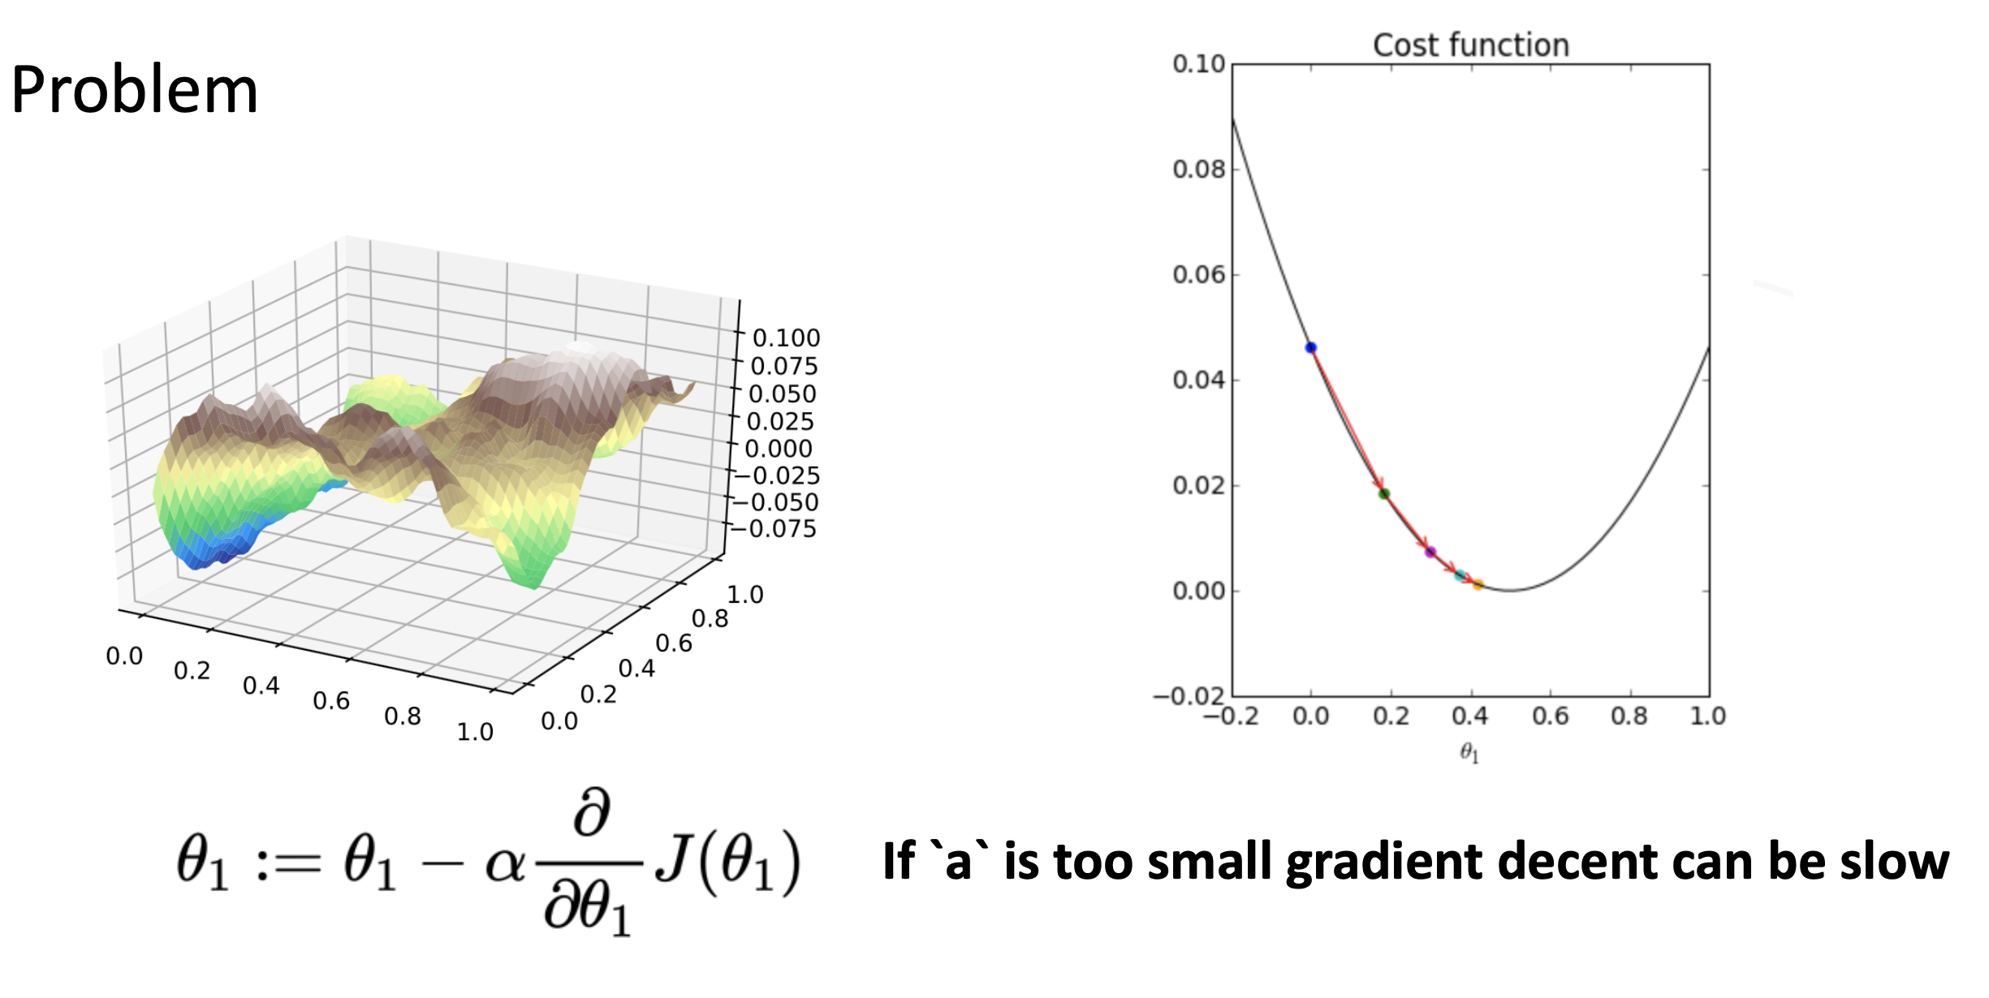
Basic Elements in Deep Learning

Slide 16
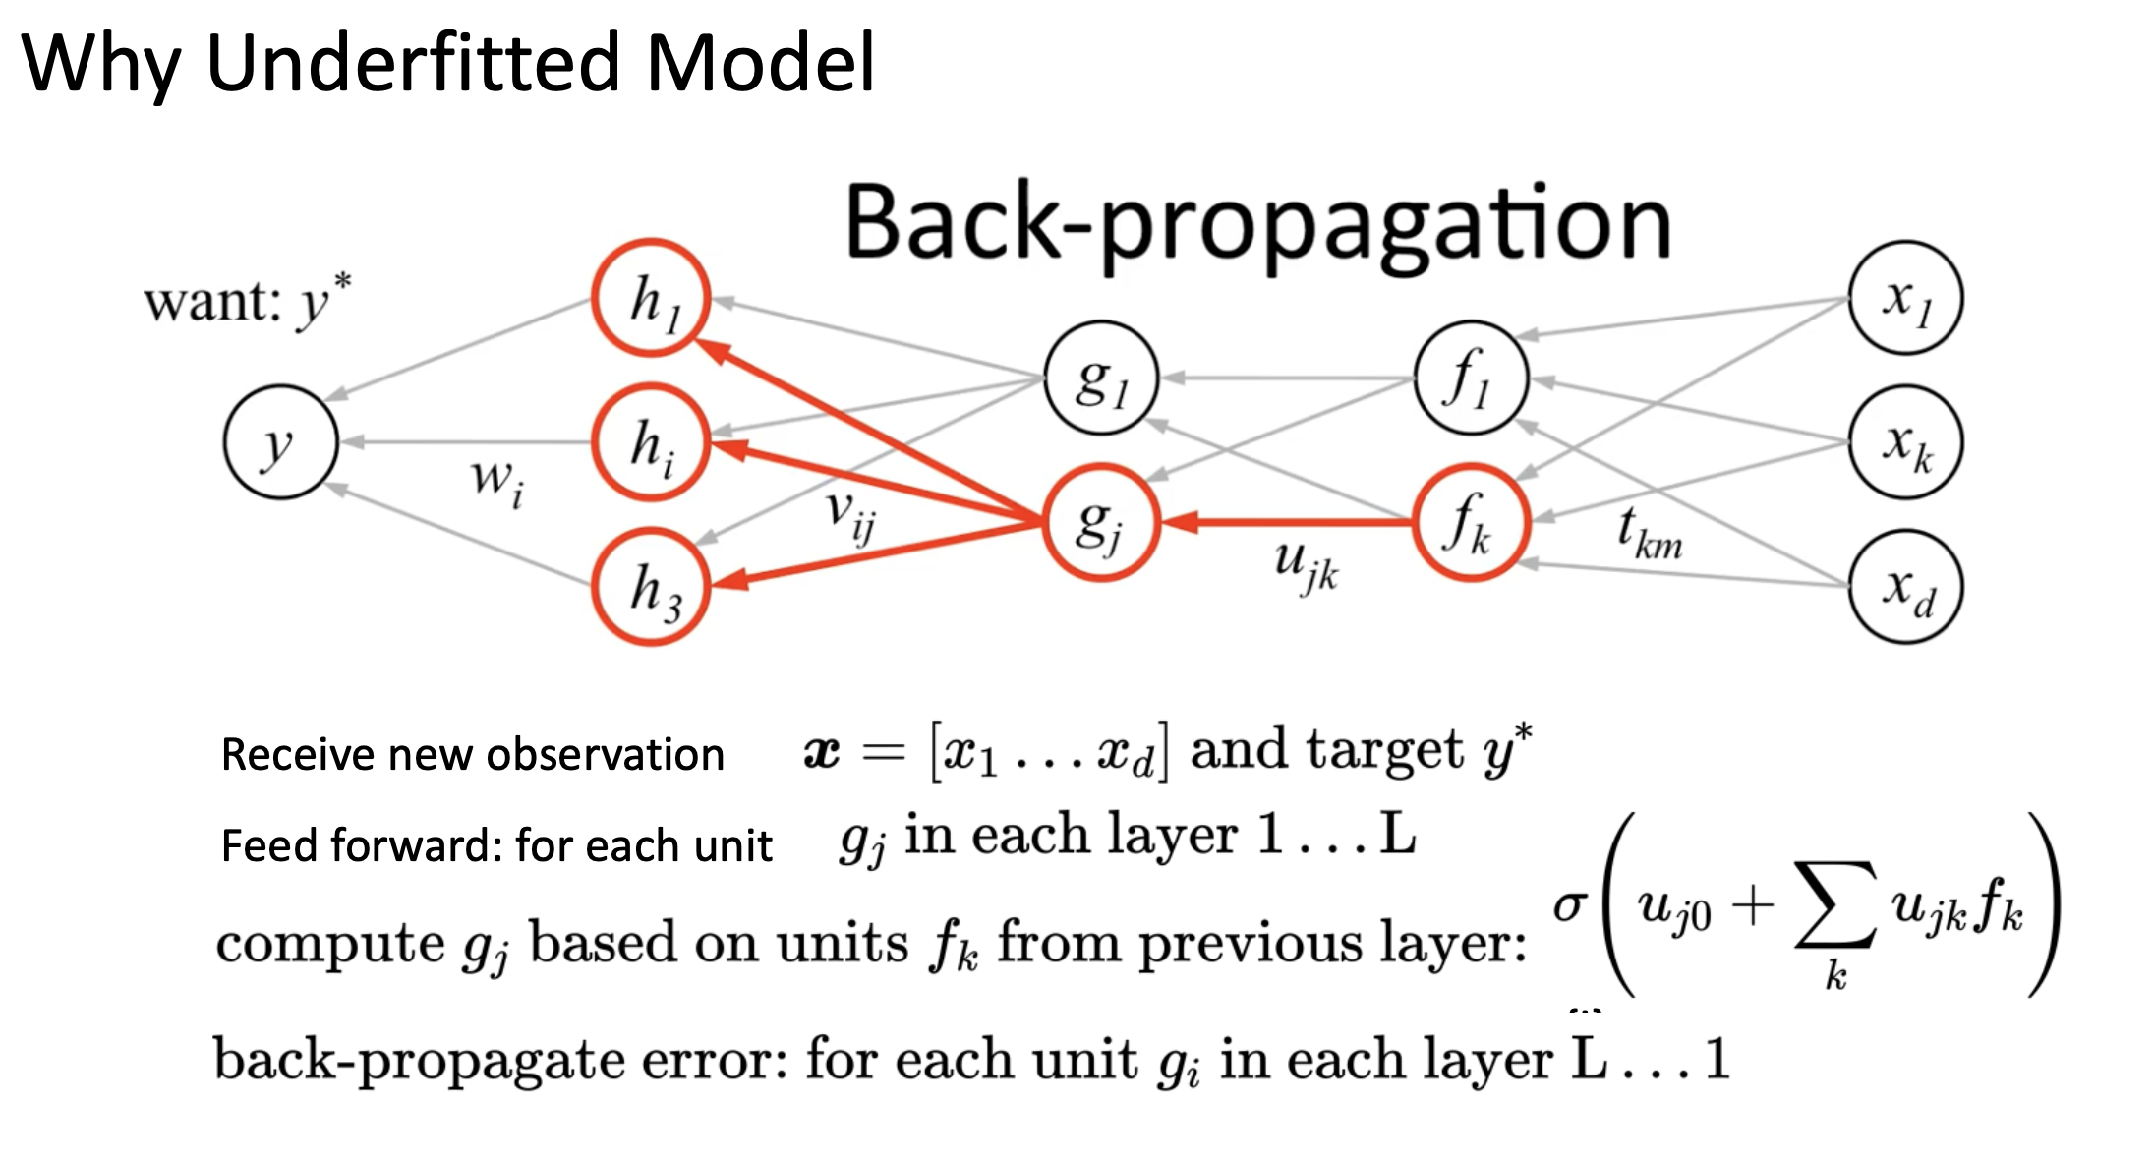
Basic Elements in Deep Learning

Slide 17
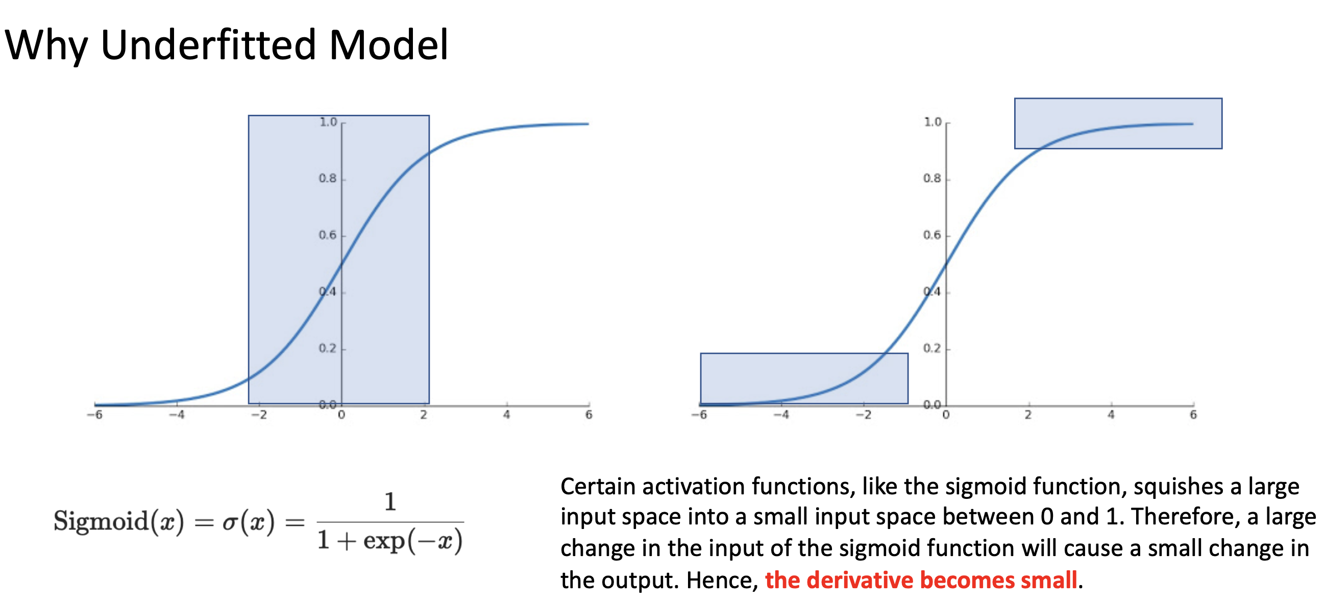
Basic Elements in Deep Learning

Slide 18
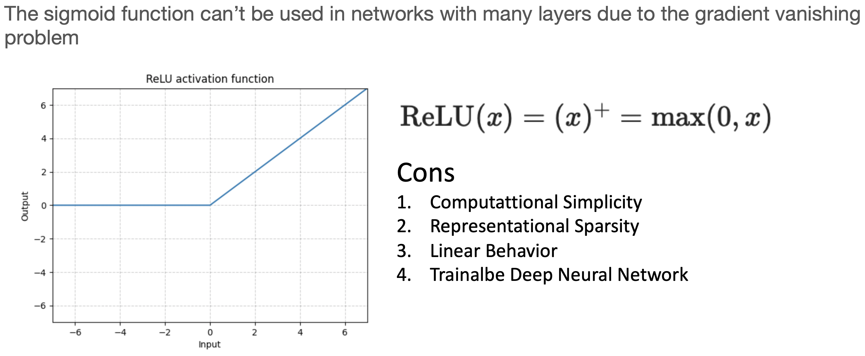
Basic Elements in Deep Learning

Slide 19
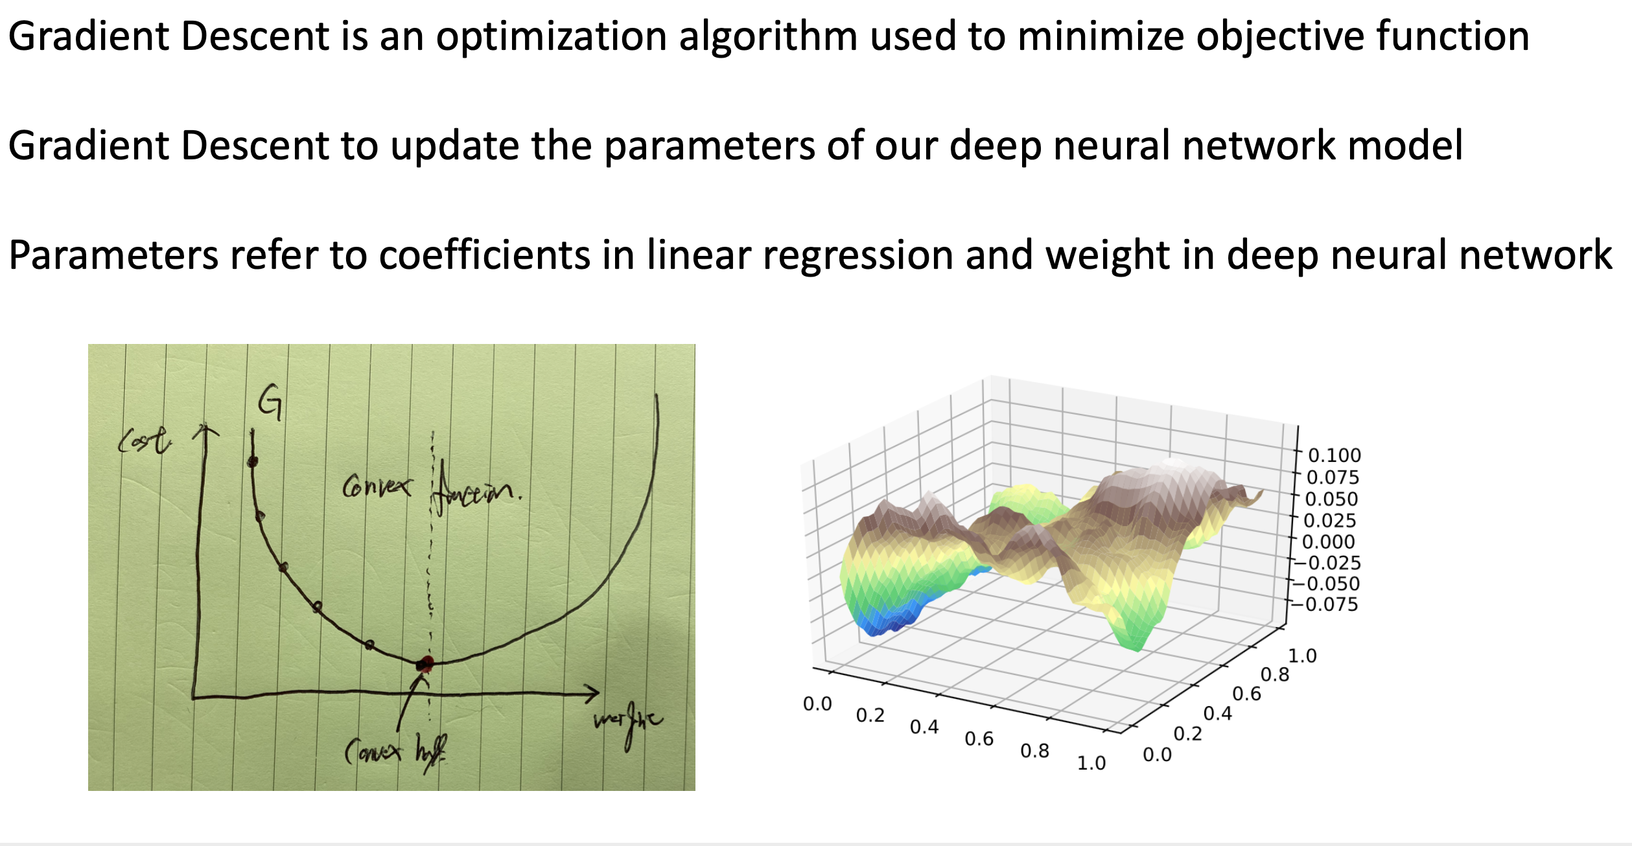
Basic Elements in Deep Learning

Slide 20
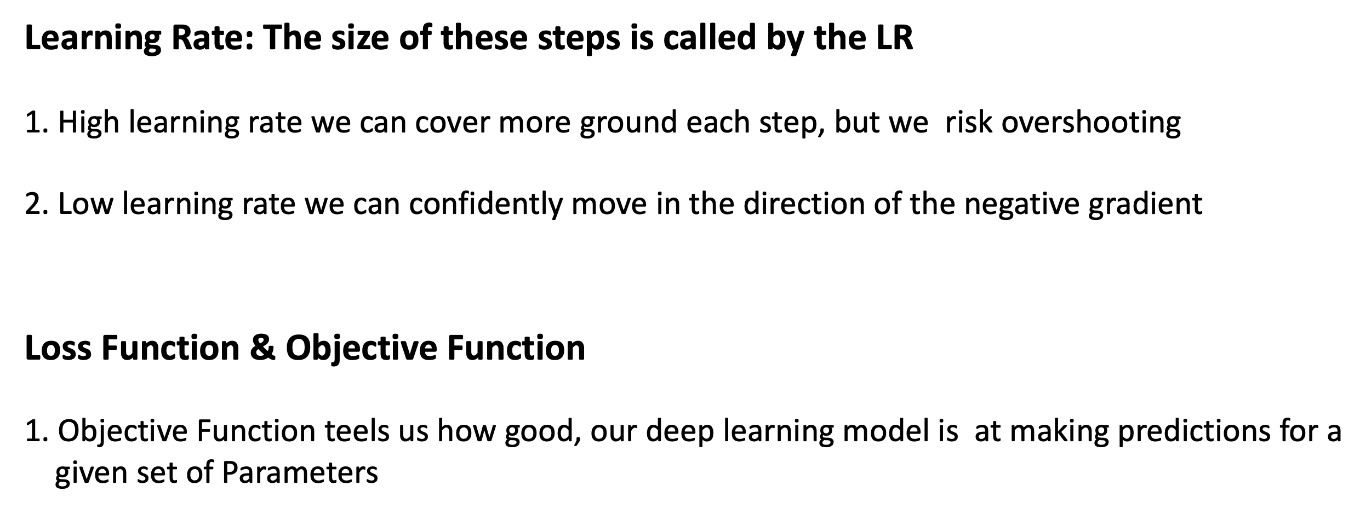
Basic Elements in Deep Learning

Slide 21
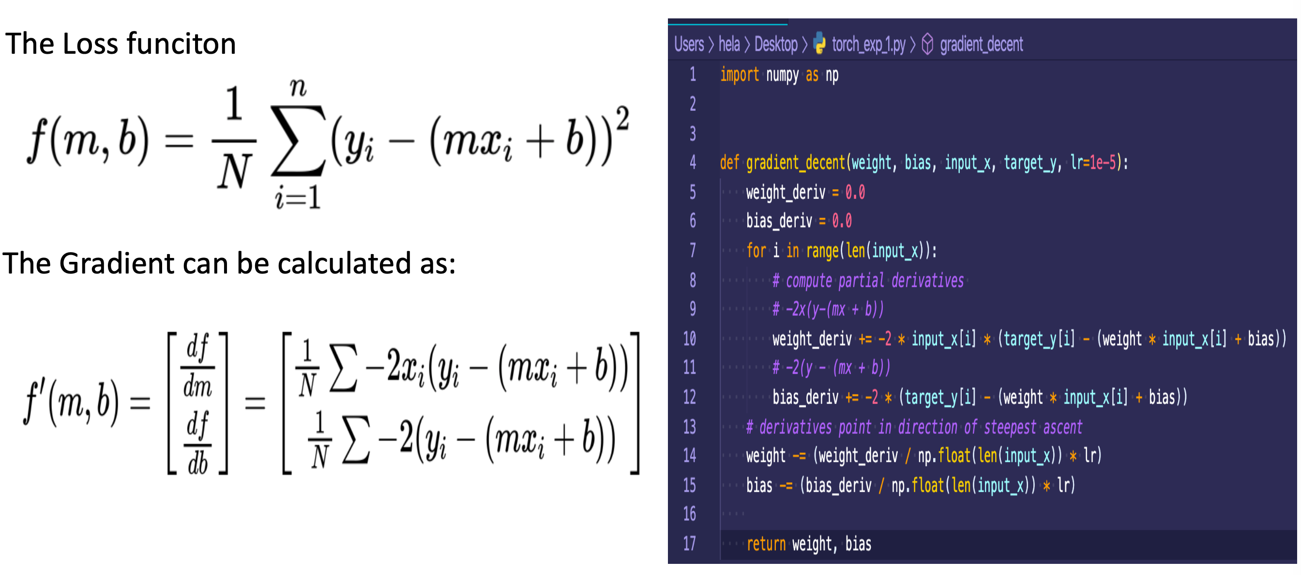
Basic Elements in Deep Learning

Slide 22
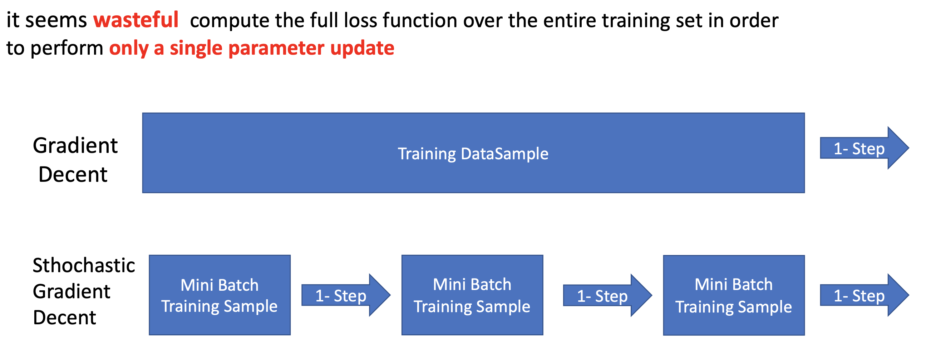
Basic Elements in Deep Learning

Slide 23
Outline
Why Deep Learning
Basic Elements in Deep Learning
Mathematics for Machine & Deep Learning
Hands on TensorFlow & TensorBoard
TensorFlow MLP implementation with MNIST DataSample
Q & A

Slide 24
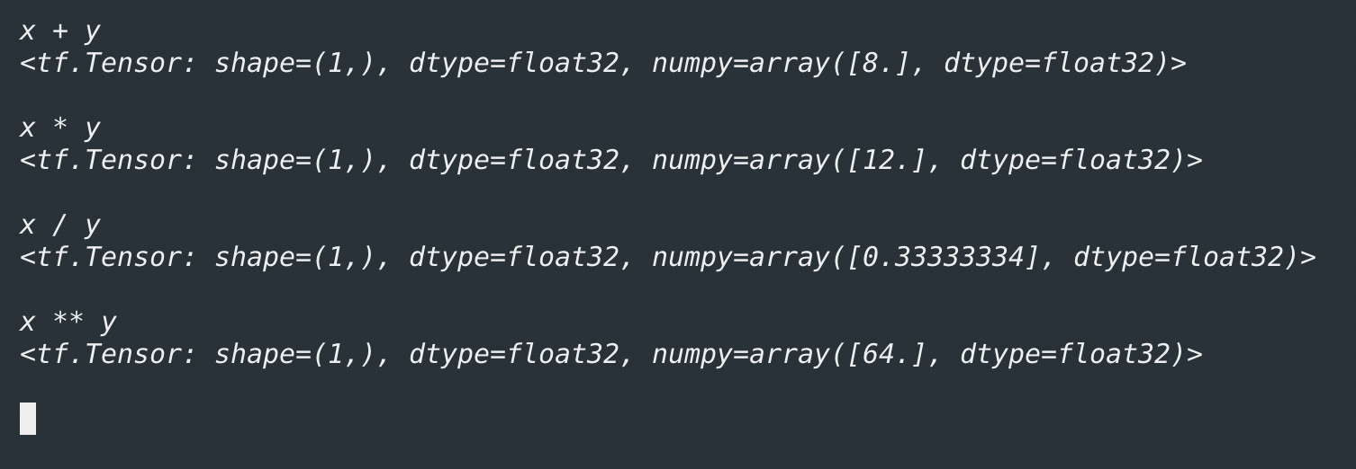
Mathematics for Machine & Deep Learning
A scalar is an element of a field which is used to define a vector space
operations with them, namely addition, multiplication, division, and exponentiation

Slide 25
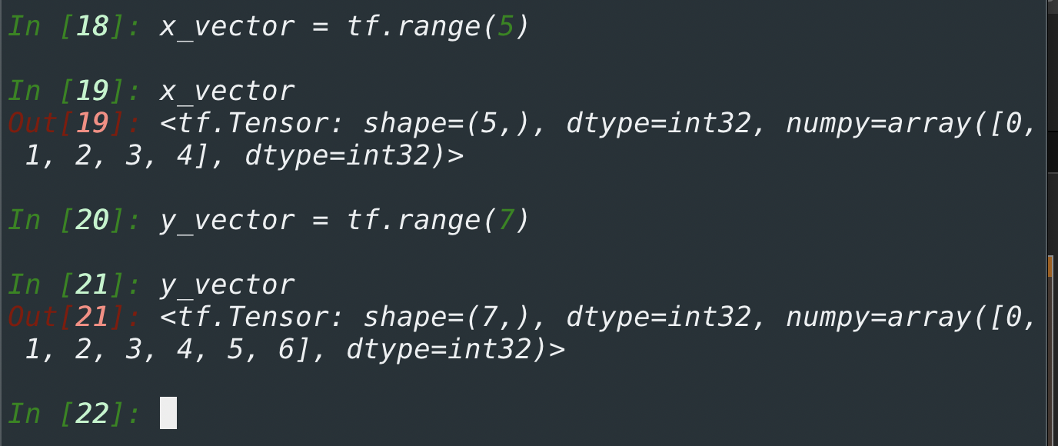
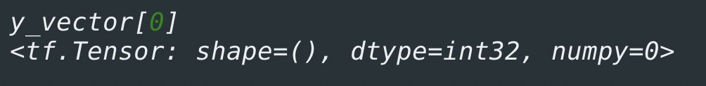
Mathematics for Machine & Deep Learning
A Vector as simply a list of scalar values
where 𝑥1,…,𝑥𝑛, x1,…,x𝑛 are elements of the vector.
we access any element by indexing into the tensor.

Slide 26
Mathematics for Machine & Deep Learning
A dimensionality of a tensor to refer to the number of axes that a tensor has. In this sense, the dimensionality of some axis of a tensor will be the length of that axis

Slide 27
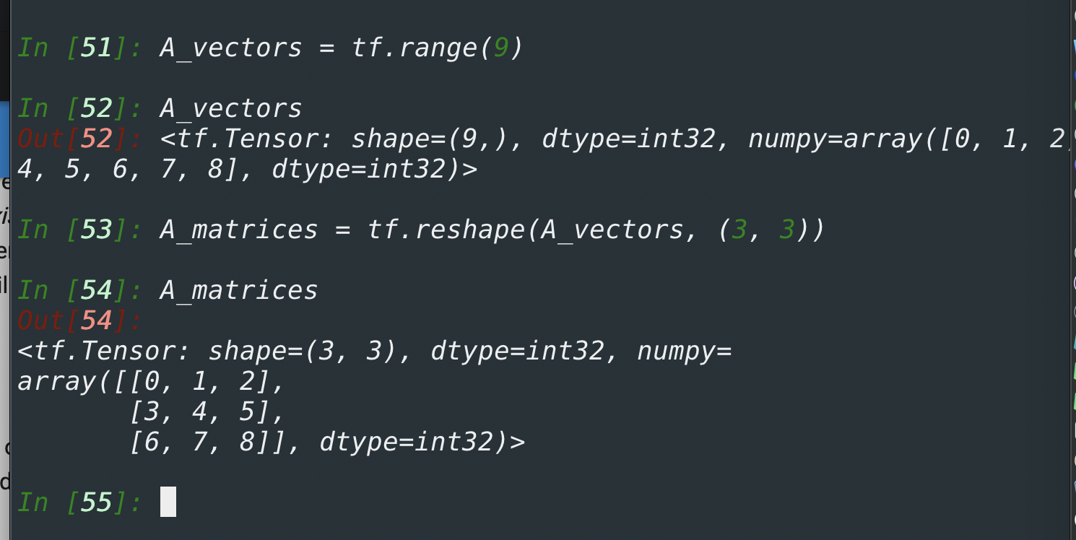
Mathematics for Machine & Deep Learning
Just as vectors generalize scalars from order zero to order one, matrices generalize vectors from order one to order two. Matrices, which we will typically denote with bold-faced, capital letters
e.g., 𝐗 , 𝐘 , and 𝐙 are represented in code as tensors with two axes.

Slide 28
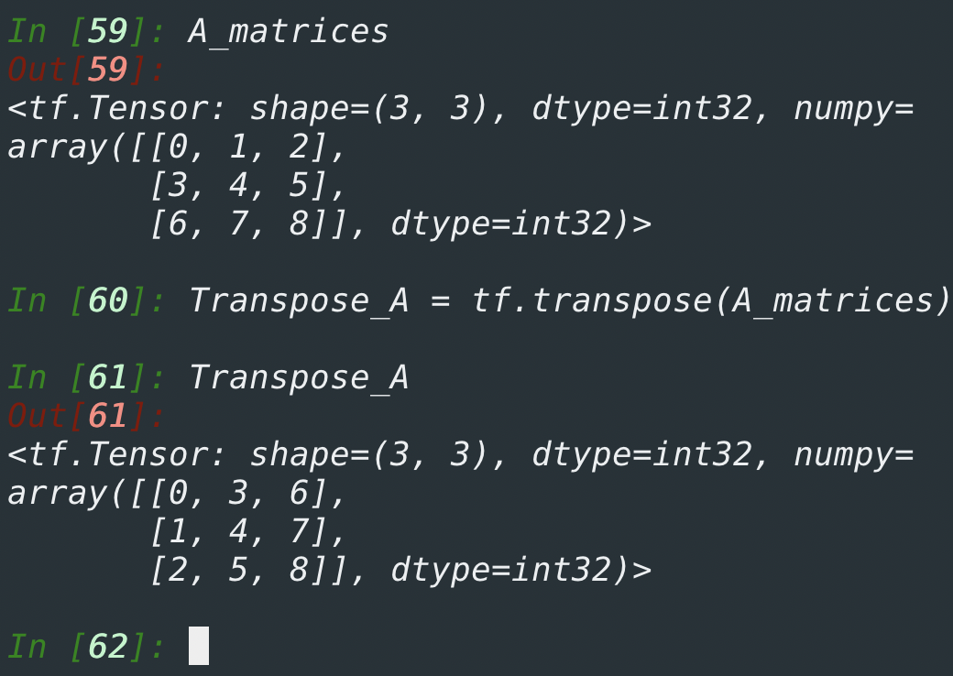
Mathematics for Machine & Deep Learning
we want to flip the axes. When we exchange a matrix’s rows and columns, the result is called the transpose of the matrix

Slide 29
Mathematics for Machine & Deep Learning
Just as vectors generalize scalars, and matrices generalize vectors, we can build data structures with even more axes. Tensor
Tensors will become more important when we start working with images, which arrive as 𝑛 -dimensional arrays with 3 axes corresponding to the height, width, and a channel axis for stacking the color channels

Slide 30
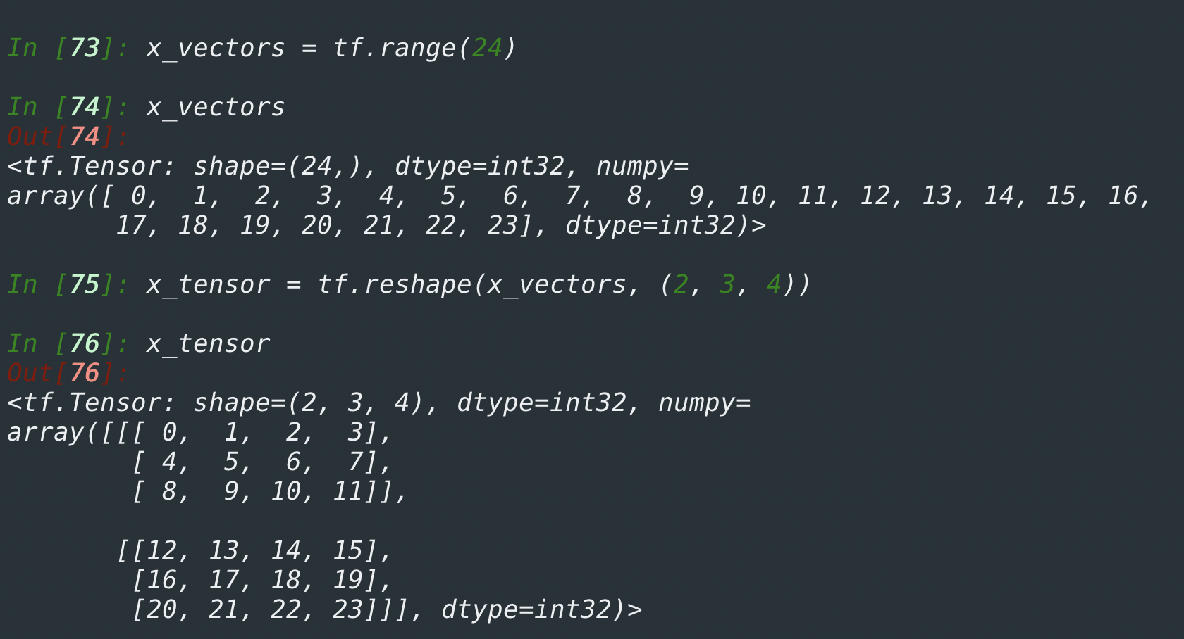
Mathematics for Machine & Deep Learning

Slide 31
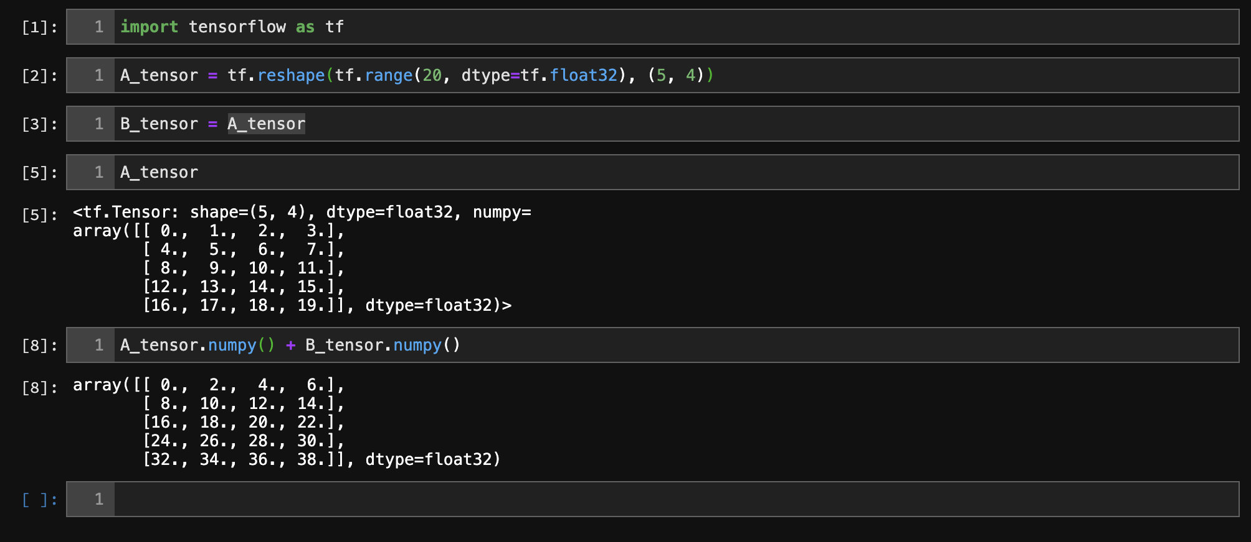
Mathematics for Machine & Deep Learning
Any two tensors with the same shape, the result of any binary element-wise operation will be a tensor of that same shape

Slide 32
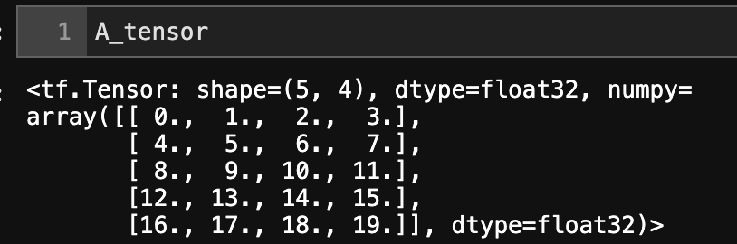
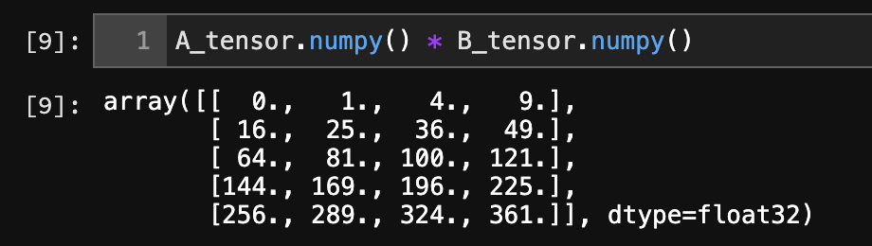
Mathematics for Machine & Deep Learning
Specifically, elementwise multiplication of two matrices is called their Hadamard product
Multiplying or adding a tensor by a scalar also does not change the shape of the tensor, where each element of the operand tensor will be added or multiplied by the scalar.

Slide 33
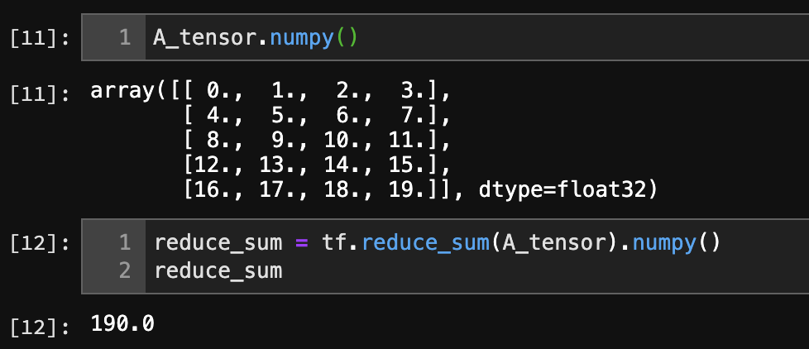
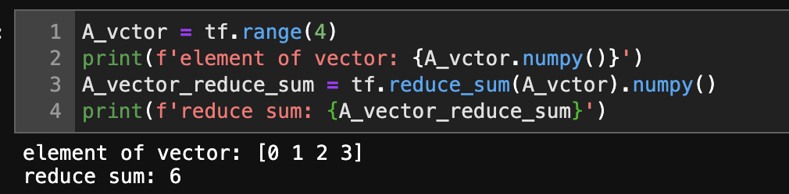
Mathematics for Machine & Deep Learning
Reduction: One useful operation that we can perform with arbitrary tensors is to calculate the sum of their elements. In mathematical notation, we express sums using the ∑ symbol. To express the sum of the elements in a vector 𝐱 of length 𝑑

Slide 34
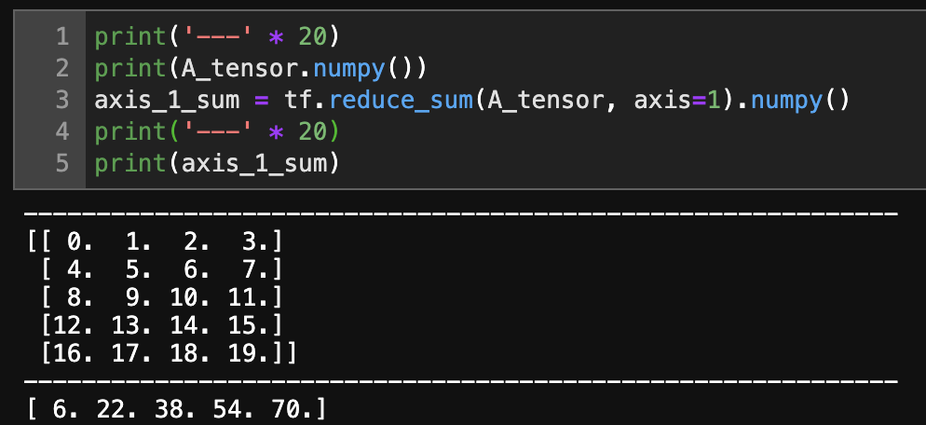
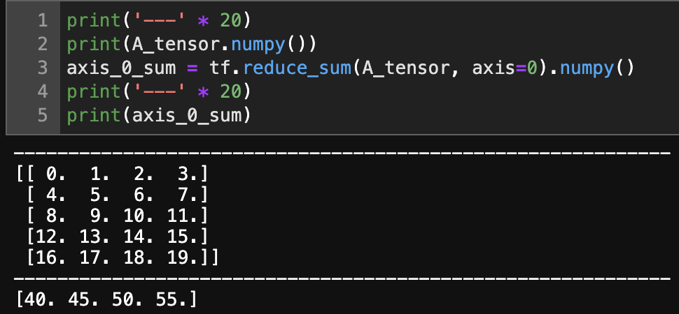
Mathematics for Machine & Deep Learning
Reduction: Specifying axis=1 will reduce the column dimension (axis 1) by summing up elements of all the columns. Thus, the dimension of axis 1 of the input is lost in the output shape.
Axis value: 1
Axis value: 0

Slide 35
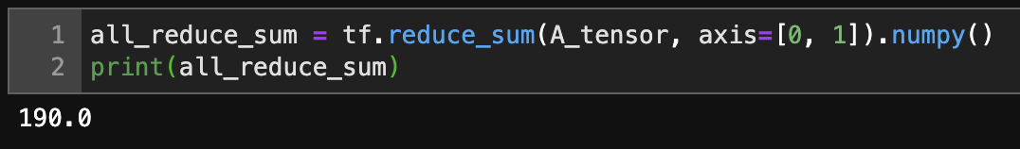
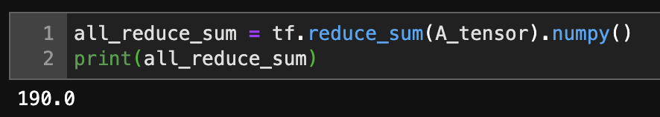
Mathematics for Machine & Deep Learning
Reducing a matrix along both rows and columns via summation is equivalent to summing up all the elements of the matrix.

Slide 36
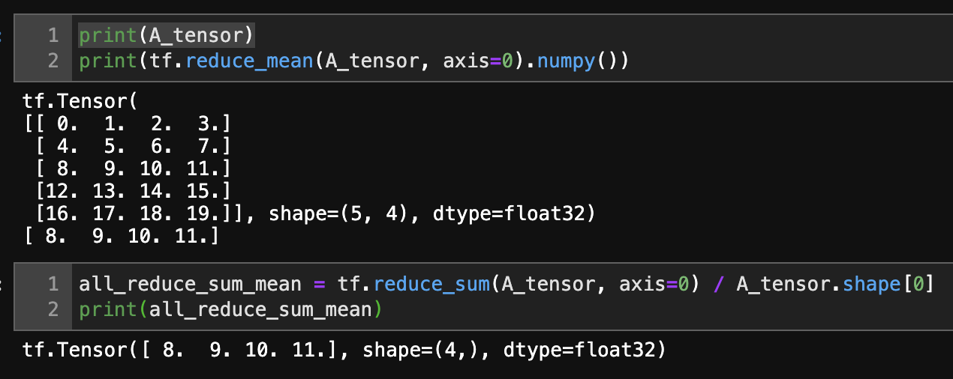
Mathematics for Machine & Deep Learning
Likewise, the function for calculating the mean can also reduce a tensor along the specified axes

Slide 37
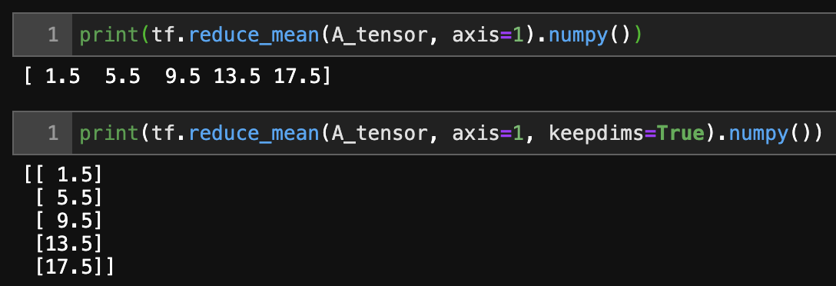
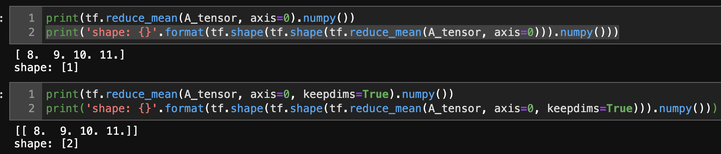
Mathematics for Machine & Deep Learning
It can be useful to keep the number of axes unchanged when invoking the function for calculating the sum or mean

Slide 38
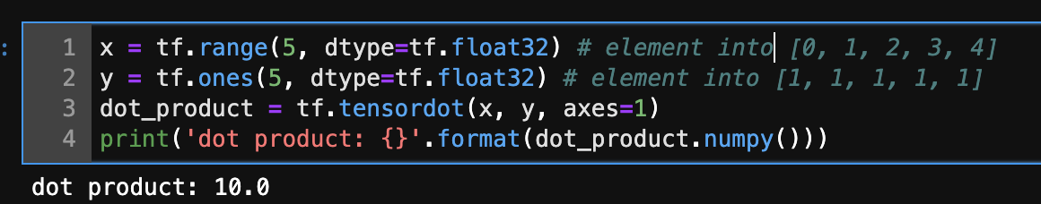
Mathematics for Machine & Deep Learning

Slide 39
Mathematics for Machine & Deep Learning
Summary
Scalars, vectors, matrices, and tensors are basic mathematical objects in linear algebra
Vectors generalize scalars, and matrices generalize vectors
Scalars, vectors, matrices, and tensors have zero, one, two, and an arbitrary number of axes, respectively

Slide 40
Mathematics for Machine & Deep Learning
Summary
A tensor can be reduced along the specified axes by sum and mean.
Elementwise multiplication of two matrices is called their Hadamard product. It is different from matrix multiplication
We can perform a variety of operations over scalars, vectors, matrices, and tensors

Slide 41
Outline
Why Deep Neural Network
Basic Elements in Deep Neural Network
Mathematics for Machine & Deep Learning
Hands on TensorFlow & TensorBoard
TensorFlow MLP implementation with MNIST DataSample
Q & A

Slide 42
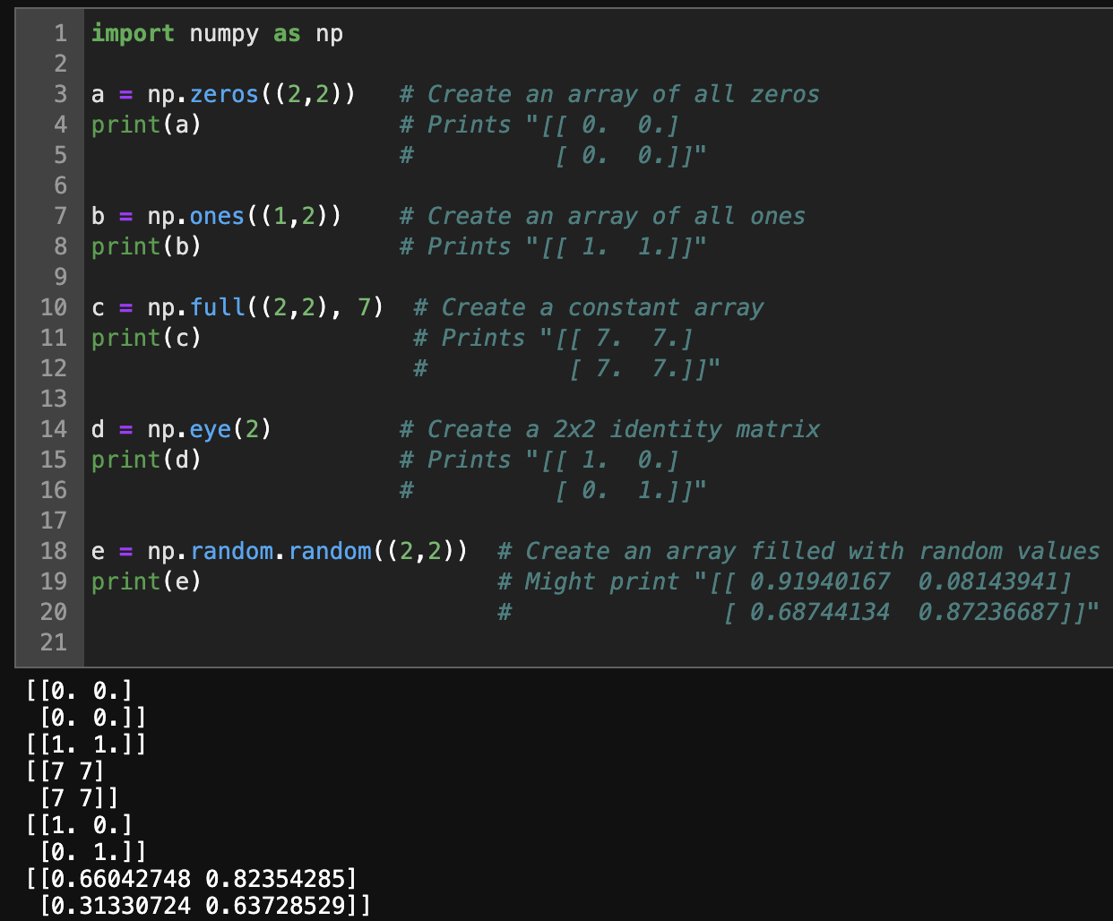
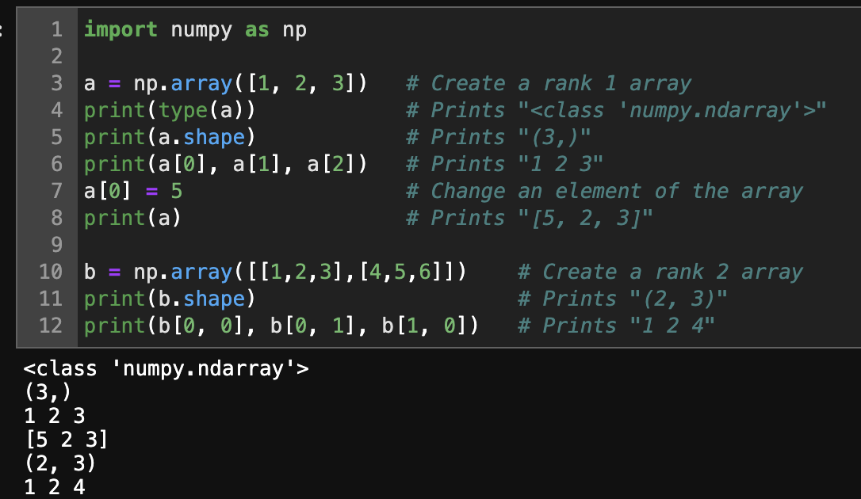
Hands on TensorFlow & Tensor Board
A Numpy array is a grid of values, all of the same type, and is indexed by a tuple of nonnegative integers.
The number of dimensions is the rank of the array the shape of an array is a tuple of integers giving the size of the array along each dimension.

Slide 43
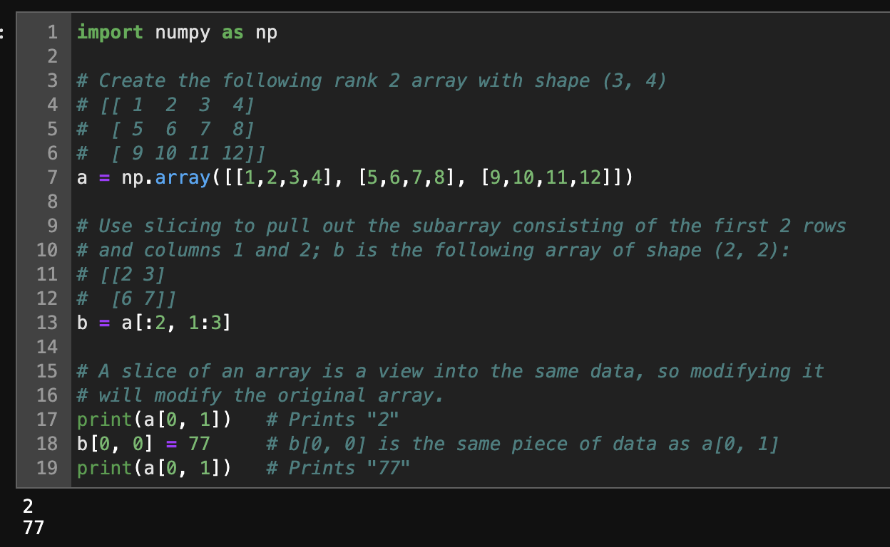
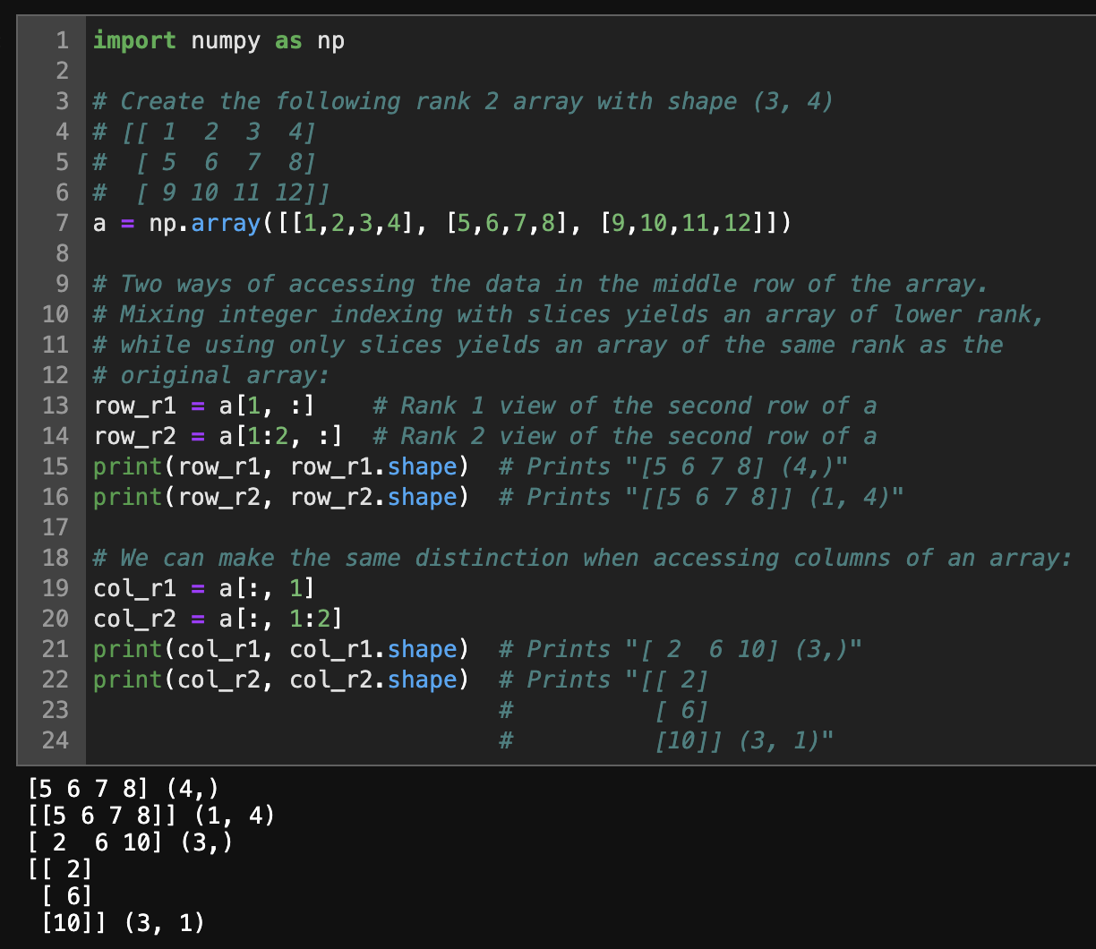
Hands on TensorFlow & Tensor Board
Slicing: Similar to Python lists, numpy arrays can be sliced. Since arrays may be multidimensional, you must specify a slice for each dimension of the array

Slide 44
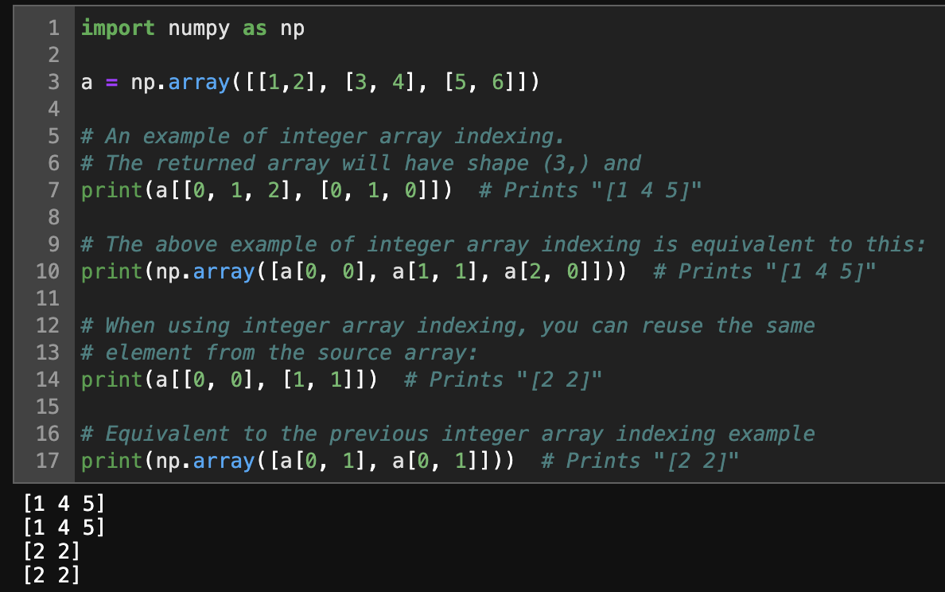
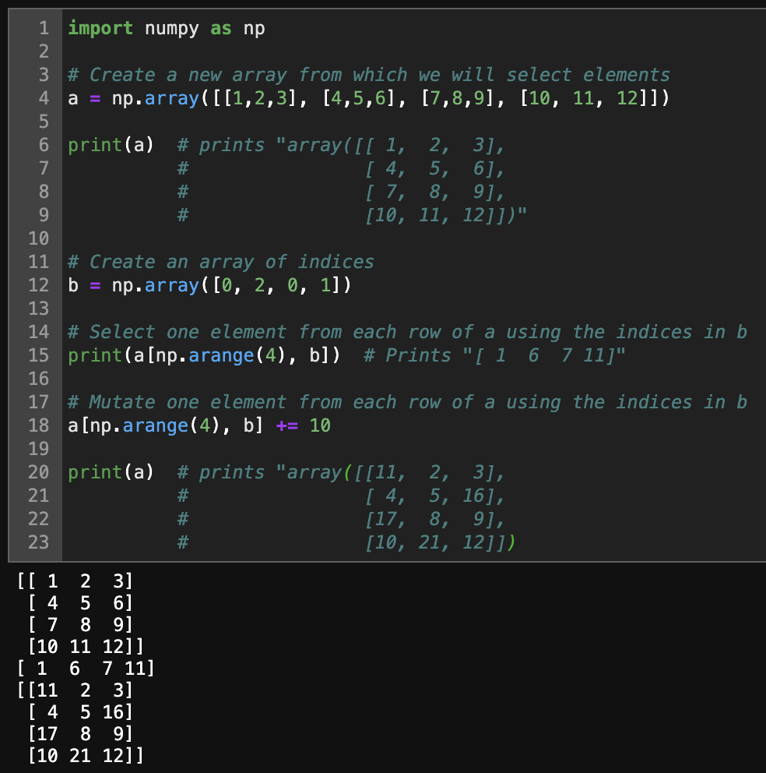
Hands on TensorFlow & Tensor Board
Integer array indexing: When you index into numpy arrays using slicing, the resulting array view will always be a subarray of the original array. In contrast, integer array indexing allows you to construct arbitrary arrays using the data from another array. Here is an example:

Slide 45
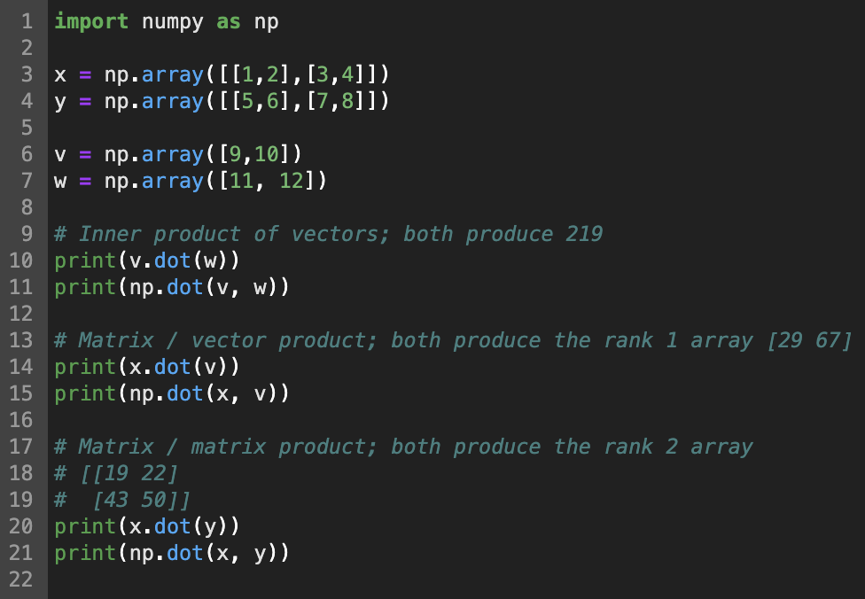
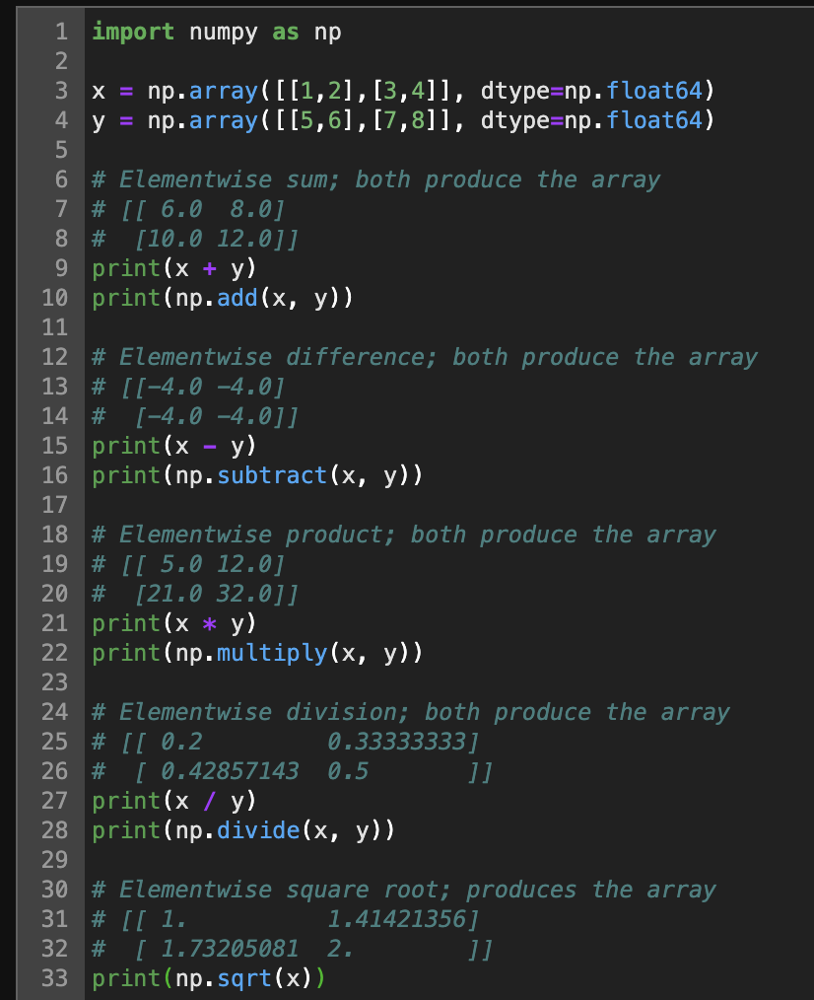
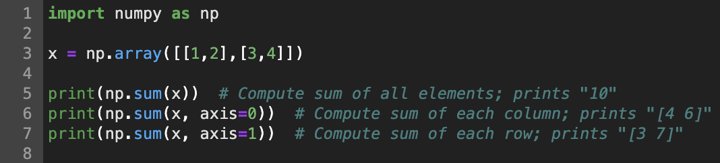
Hands on TensorFlow & Tensor Board
Basic mathematical functions operate elementwise on arrays, and are available both as operator overloads and as functions in the numpy module

Slide 46
Hands on TensorFlow & Tensor Board
Basic mathematical functions operate elementwise on arrays, and are available both as operator overloads and as functions in the numpy module

Slide 47
Outline
Why Deep Neural Network
Basic Elements in Deep Neural Network
Mathematics for Machine & Deep Learning
Hands on TensorFlow & TensorBoard
TensorFlow MLP implementation with MNIST DataSample
Q & A

Slide 48
Outline
Why Deep Neural Network
Basic Elements in Deep Neural Network
Mathematics for Machine & Deep Learning
Hands on TensorFlow & TensorBoard
TensorFlow MLP implementation with MNIST DataSample
Q & A

